Slide 1


OBJECT ORIENTED PROGRAMMING PROJECT
Air University Kamra
PHARMACY MANAGEMENT SYSTEM
Group Members
Wasif Ali (245187)
Anisa Khan (245215)
DEPARTMENT OF COMPUTER SCIENCE | AIR UNIVERSITY – KAMRA CAMPUS

Slide 2






INTRODUCTION
A desktop app to manage pharmacy operations
Handles medicines, customers, and inventory
Separate panels for Admin, Seller and Customer
Technologies Used:
  Java (Swing for GUI)
  MySQL (if database is used)
  Eclipse IDE
User
Application
Database
1/12

Slide 3
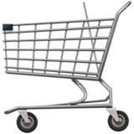

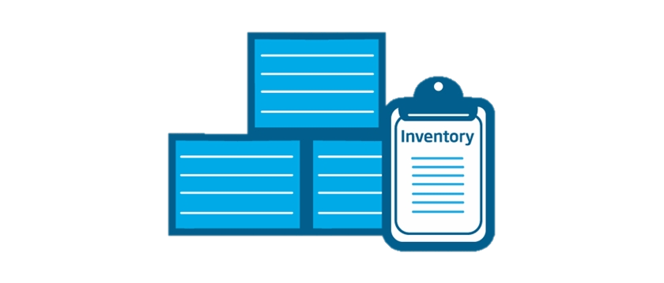

SYSTEM OBJECTIVES
Manage medicines efficiently
Provide separate panels for admin, seller customer
Track inventory
Simplify purchase processes
User-friendly interface
2/12

Slide 4


SYSTEM ARCHITECTUR
High-level architecture:
  GUI Layer (Java Swing)
  Controller Layer (Handles user actions)
  Backend (Database or storage)
3/12

Slide 5


Modules Overview
Admin Panel:
  Add/edit/delete medicines
  Manage inventory
Seller Panel:
  Adds sales
  Updates stock
  Views assigned products
Customer Panel:
  Browse medicines
  Place orders
  View history
4/12

Slide 6

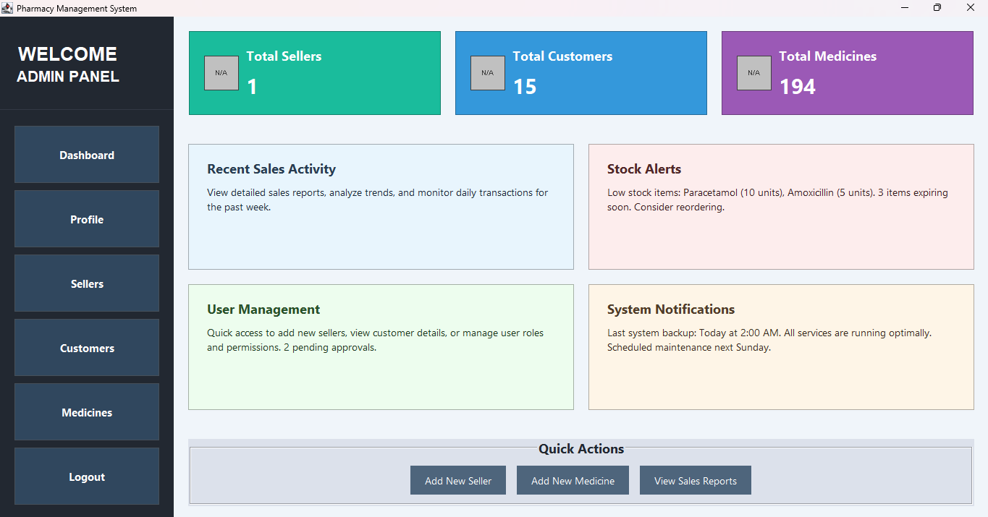

ADMIN PANEL FEATURES
Secure Login
Dashboard to view/manage:
  Stock
  Orders
  Customers
Real-time updates to inventory
5/12

Slide 7

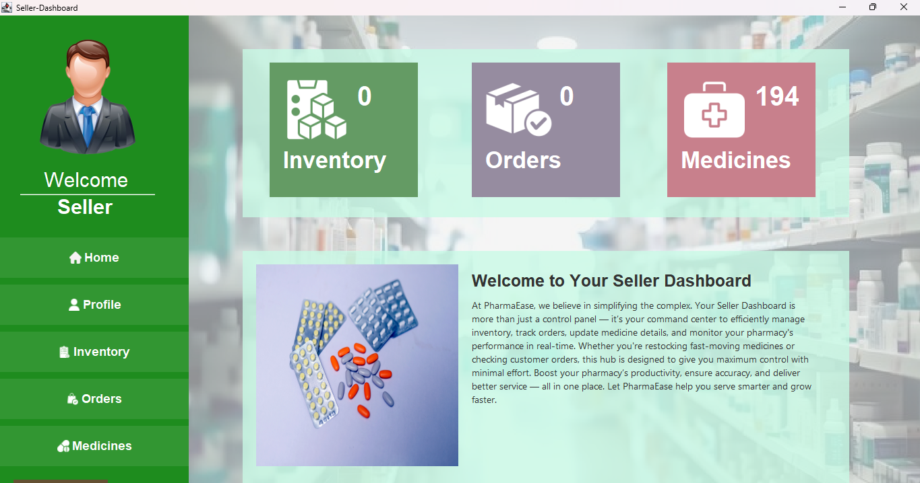


SELLER PANEL FEATURES
Logs in with credentials
Views and updates assigned products
Records sales transactions
Manages stock availability
Simple, task-focused UI
6/12

Slide 8


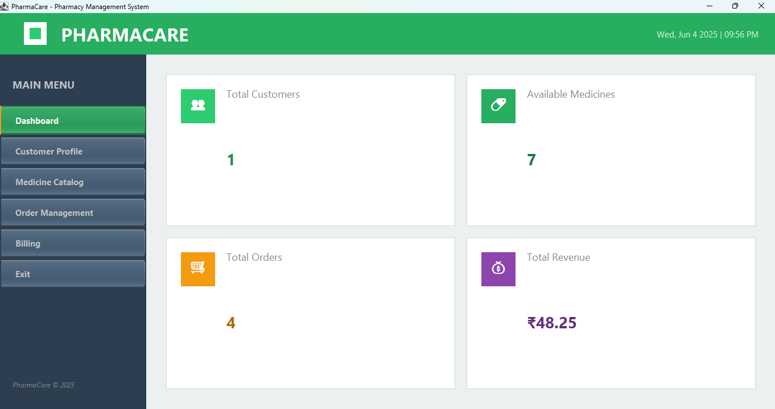



CUSTOMER PANEL FEATURES
Login/Sign Up
Browse and search for medicines
Add to cart and checkout
View purchase history
Print and Save Bill
7/12

Slide 9
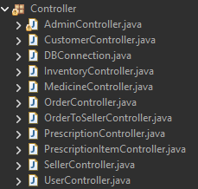
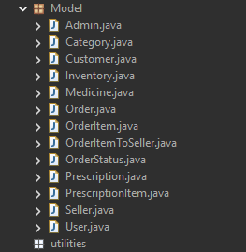
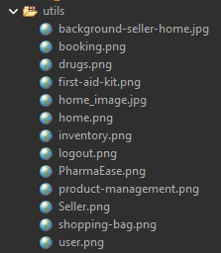
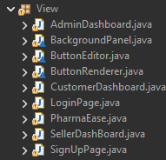

PROJECT STRUCTURE
Organized with packages: controller, view, model
Controller: Handles actions, DB logic
Dashboard: Admin/Seller/Customer UIs
Improves modularity and future scalability
[Login/Register] → [Dashboard (Admin/Seller/Customer)]
↓
[Controller Class]
↓
[Database]
8/12

Slide 10
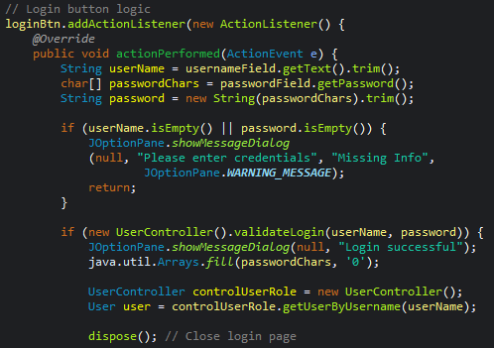
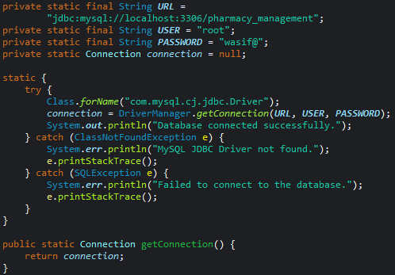
CODE SNIPPET HIGHLIGHT
Login Validation
MySQL Database Connection
9/12

Slide 11
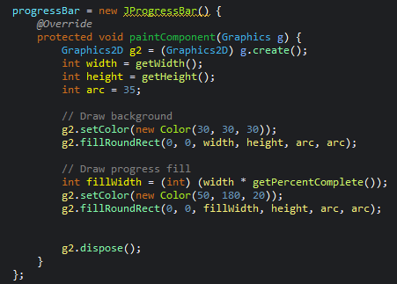
CODE SNIPPET HIGHLIGHT
Progress Bar
Visual Output
10/12

Slide 12



CHALLENGES & SOLUTIONS
Challenges:
  Swing UI layout complexity
  Linking multiple panels
  Inventory updates in real-time
Solutions:
  Used null layouts for precision
  Modular class design
  Controller classes to manage logic
11/12

Slide 13




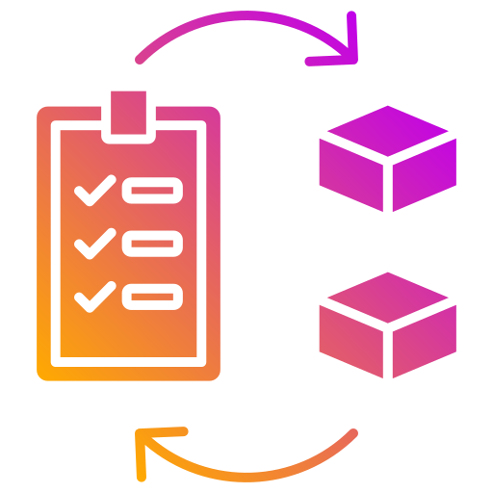

CONCLUSION
A robust desktop app for pharmacy management
Simplifies tasks for admin, seller, and customer
Improves accuracy in stock and sales tracking
User-friendly and modular design for easy updates
Ready for future upgrades like billing and online orders
Admin
Seller
Customer
12/12

Slide 14
THANK YOU

